Slide 1
SAMSUNG SDS | AGENTIC AI USE CASE · DEVELOPMENT APPROVAL REQUEST
EVENT-DRIVEN · AGENTIC AI · RUNTIME HEALING
Self-Healing AI Agent
for UI Automation
The moment an automation step fails, the Healing Agent wakes, finds the moved element with fine-tuned AI and repairs the selector at runtime, on hardware we already own.
Confidential
SAMSUNG SDS
Notes:
One sentence framing: "Our robots break every time a website changes. This AI agent makes them heal themselves, the moment a step fails."
Point at the event log on the right. The step was written against jobTitle and the release renamed it to positionTitle. The failed lookup raised an event; the Healing Agent read the live page, recalled what the field looked like when it last worked, reasoned over the candidates, proved the new address on the page, and the robot carried on - 6.2 seconds, nothing in the script edited.
If someone asks cost up front: "Fifty-four lakh, pays back in about twelve months - the commercial case, slide ten." Then move on.

Slide 2








SAMSUNG SDS | AGENDA
From the problem to the business case, in eight steps.
01
02
03
04
The problem
The Healing Agent
Healing flow
Architecture
One renamed field stops a robot.
Event-driven. Heals at runtime.
From failure event to recovery.
One GPU host, shared RAG memory.
05
06
07
08
AI & fine-tuning
Live demo
Benefits
Commercial case
Trained on 758k real breakages.
Watch a release break, then heal.
For the business and for engineering.
~16,800 engineer-hours back a year.
PAGE 02 / 10
Confidential
SAMSUNG SDS
Notes:
Eight parts: the problem, the Healing Agent and its healing flow, the architecture and the AI inside it, the demo, then what it is worth. If time is short, go from 'The Healing Agent' straight to the demo and finish on the commercial case.

Slide 3









SAMSUNG SDS | USE CASE · PROBLEM STATEMENT & SCOPE
Even a minor UI change can disrupt an entire automation.
A renamed field stops the robot, even though the field is still there.
ONE BROKEN SELECTOR, FIXED BY HAND
Failure
01
Triage
02
Repair
03
Redeploy
04
4-8 h to notice
30-45 min to diagnose
2-4 h to fix
2-4 h to land
Today: 1-2 days per broken selector With the Healing Agent: ~6 seconds
SCOPE OF THE PROJECT
IN SCOPE
NOT IN PHASE 1
Web bots
Fleet-wide RAG memory
Rewriting automations
CSS and XPath
Audit trail
Desktop, mainframe, Citrix
Runtime healing, event-driven
On-prem AI, no cloud
Deleted page elements
PAGE 03 / 10
Confidential
SAMSUNG SDS
Notes:
This slide is for whoever in the room has never written a selector. The analogy that lands: a selector is a postal address for a button. The building did not move; the street got renamed.
Walk the four cards left to right. The point is the handoffs, not any single number. The 4-8 hour detection window is the one that stings for ops: nobody is watching at two in the morning. These durations are typical, not measured on our estate - offer to instrument them.
Scope: web robots on Selenium or Playwright, both selector languages, healed at runtime by the event-driven agent. Nobody is asked to rewrite an automation. Desktop, mainframe and Citrix UIs are not in phase 1, and a control a vendor deleted is reported as gone, never invented.

Slide 4







SAMSUNG SDS | HOW IT WORKS · THE HEALING AGENT
An event-driven AI agent heals the robot in about six seconds.
A selector break raises an event, the healing AI agent steps in before the automation fails.
01 EVENT-DRIVEN TRIGGER
02 SELECTOR RECOVERY PIPELINE
03 CONFIDENCE-BASED
Senses the failure
Reasons over the page
Execution criteria
Missed selector = failure event
The step's intent and old selector
Live page: ~900 elements, via JS
Last-known-good fingerprint
1
RAG memory recall
instant
AUTO-HEAL
confident, proven step
Reuses a fix the fleet proved.
2
Semantic similarity
0.3 s
REFUSE
Human intervention required
8 signals: 900 elements to top 8.
3
Fine-tuned AI
~5 s
97%
accuracy on high-confidence heals
Element not found -> Healing AI Agent event invoked
Checker + LLM pick one, by index.
209 of 211, unseen websites
4
Bind + validate
0.2 s
Proves it on the live page.
Every heal audited and learned
Index, not text. The AI cannot invent a selector.
Fails open. Never stops a robot.
Policy decides, not the model.
PAGE 04 / 10
Confidential
SAMSUNG SDS
Notes:
This is the pivot. Read it left to right: what wakes the agent, how it reasons, and how it decides to act.
Left: the agent is event-driven. It costs nothing until a selector misses; that miss is the trigger, and the agent runs inline while the robot waits - no ticket, no redeploy, nobody woken at two in the morning.
Middle: the selector recovery pipeline. RAG memory and semantic similarity are fast and deterministic; only the fine-tuned AI step needs the GPU, which is why a heal takes about six seconds and not sixty. The AI is handed a numbered list harvested from the live page and answers with an index - it is structurally incapable of inventing a selector.
Right: confidence-based execution. When the agent is confident on a step it has seen working, it heals on its own - and on its high-confidence decisions it was right 209 times out of 211, on websites it had never seen. When it is unsure, a person reviews; when nothing matches, it refuses and the step fails loudly, exactly as today. A step that was never seen working is never auto-applied.
Keep model names off this slide; they are on the AI slide for anyone who asks.

Slide 5













SAMSUNG SDS | ARCHITECTURE · RAG MEMORY & TECHNOLOGY STACK
One Healing Agent host serves the whole Ui automation fleet.
Automation keep the browser. One shared host runs the agent, its fine-tuned AI and its RAG memory.
HOST · NO GPU
HEALING AGENT HOST · ONE GPU
TECHNOLOGY STACK
ROBOT
Automation script
RAG memory
RETRIEVAL-AUGMENTED
Python · Selenium · Playwright
existing, unchanged
proven fleet fixes · last-known-good fingerprints
HEALING AGENT
find()
learn
retrieve
FastAPI · Uvicorn
fingerprints
only
Agent client
Healing Agent
Similarity engine
AI
bis.py, fires on failure
FastAPI over HTTPS
8 signals + embeddings
Fine-tuned LLM + checker · llama.cpp · CUDA
an index,
not a selector
harvest, bind
RAG MEMORY
SQLite fixes · JSON fingerprints
Browser
Execution policy
Fine-tuned AI
Selenium or Playwright
confidence-based
checker + LLM on GPU
INFRASTRUCTURE
24 GB GPU server · internal HTTPS
PAGE 06 / 10
Confidential
SAMSUNG SDS
Notes:
One GPU, many robots: "We buy the intelligence once, not once per robot."
Left box: the robot host keeps its existing script and gains one client file. That client is the agent's trigger - it fires the moment a lookup fails - and it runs the JavaScript harvest and the final bind. No GPU, no model; rollout is a package install.
The arrows between the boxes are the security story: element fingerprints cross the wire - never the page, never a screenshot, never the values the robot is typing - and the agent answers with an index, never a selector. The robot binds and proves it on the live page itself.
Top of the agent host: RAG memory. Every decision is grounded in fixes the fleet already proved and in what this element looked like the last time the step worked; every verified heal is written back, so a break one robot solves is free for every robot after it.
Right: every component is open source or open weights, on hardware we own.

Slide 6






SAMSUNG SDS | HOW IT WORKS · HEALING FLOW
Healing flow: from a failure event to a recovered step.
Event-driven and inline: the agent perceives the live page, reasons with fine-tuned AI and acts before the automation stops.
FAILURE EVENT
step 3: not found
AUTOMATION RUN waits inline while the agent heals (~6 s): no crash, no ticket, no redeploy
STEP RESUMED
run continues
trigger
resume
HEALING AGENT · AI HOST
fingerprints in · an index out
01 PERCEIVE
06 ACT
02 RECALL
03 ANALYSE
04 REASON
05 DECIDE
JavaScript collection
Bind, validate, resume
RAG memory recall
Semantic similarity analysis
Fine-tuned AI reasoning
Confidence-based execution
Runs inside the live page and fingerprints every element: text, ids, label, position.
The page proves the selector unique and visible; the step carries on.
Retrieves fixes the fleet already proved and the last-known-good fingerprint.
Eight signals, incl. sentence embeddings, score every element against the intent.
A calibrated checker opines first; a fine-tuned LLM reasons over the shortlist.
Confident on a proven step: heal. Unsure: human intervention required
~900 elements
hit = instant
900 → top 8, 0.3 s
returns an index
heal/review/refuse
0.2 s, no redeploy
07 LEARN the verified fix and its fingerprint are written back to RAG memory, so the next robot heals instantly
PAGE 05 / 10
Confidential
SAMSUNG SDS
Notes:
Walk the flow left to right, then the loop underneath.
Trigger: the robot asks for an element. When the selector misses, that miss is the event, and the Healing Agent is called inline - the robot pauses instead of crashing.
01 Perceive: the agent's JavaScript runs inside the live page and fingerprints up to about 900 elements - text, ids, ARIA labels, attributes, DOM path, position, neighbouring words - and proposes durable selectors for each, in the browser. Only those fingerprints leave the machine: never a screenshot, never the values being typed.
02 Recall: RAG memory first. If another robot already proved a fix for this step, it is reused instantly with no AI call. Otherwise the last-known-good fingerprint grounds everything that follows.
03 Analyse: semantic similarity analysis scores every element on eight signals, including sentence embeddings of the step's intent, and keeps the best eight.
04 Reason: the fine-tuned checker gives a calibrated first opinion and decides alone when it is sure; otherwise the fine-tuned LLM reasons over the shortlist. Either way the answer is an index into what the page offered.
05 Decide: confidence-based execution - heal, send to review, or refuse.
06 Act: back in the browser, the page proves the new selector is unique and visible, and the step carries on.
07 Learn: the verified fix and its fingerprint go back into RAG memory, so the next robot that meets the same change heals instantly.

Slide 7









SAMSUNG SDS | AI · FINE-TUNING & RESULTS
Fine-tuning beat scale: our 4B model outperforms a 20B one.
Two open models, fine-tuned on 758k real breakages from 1,131 live websites, tested on websites they never saw.
TRAINING DATA · ALL REAL
CHECKER · FIRST OPINION
WHEN THE AGENT IS CONFIDENT
1,131
Laya 421M + LoRA
97%
accurate
209 of 211 decisions correct
live websites crawled
0.98
+0.38
758k
AUC, vs 0.77 for heuristics
AUC gained by fine-tuning
real breakages harvested
38%
~0.3 s
1,000 test cases from websites never seen in training
of decisions settled alone
per shortlist, on GPU
208k
LIVE · REAL VENDOR UPGRADE · HR Portal 4.10 → 5.9
checker shortlists, plus 139k LLM examples
ADJUDICATOR · LLM REASONING
WITHOUT THE AGENT
WITH THE AGENT
Qwen3-4B + QLoRA
0 / 3
3 / 3
1,000
+26.5 pts
5x smaller
test cases from unseen websites
accuracy from fine-tuning
than the 20B model it beats
2.5 GB
2.2 s
onboardings completed across the upgrade, 22 repairs, every record verified in the app
SPLIT BY WEBSITE · 0 SYNTHETIC
fits a 4 GB GPU
median decision, one L4 GPU
Open weights, Apache-2.0
Every decision explained, audit-ready
Runs offline: no external API
PAGE 07 / 10
Confidential
SAMSUNG SDS
Notes:
Where does the intelligence come from? Real data, not synthetic: 1,131 live websites crawled, 758,000 real breakages harvested, and no test website ever used in training - the split is by website.
Two small open models, each fine-tuned for one job. The checker - Laya, 421 million parameters, LoRA - gives a calibrated first opinion. Fine-tuning lifted its AUC by 0.38 during training; on held-out sites it separates right from wrong at 0.98, against 0.77 for heuristics, and it settles 38 percent of decisions without calling the LLM. The adjudicator - Qwen3-4B, QLoRA - gained 26.5 points from fine-tuning in under eight GPU-hours, and the whole model is 2.5 gigabytes.
Ask the room: a 20-billion-parameter model against our 4-billion, on the same 1,000 unseen cases - who wins? Ours, significant at p below 0.001.
The headline: when the agent is confident it is right 209 times out of 211 - 99 percent. And live, across a real OrangeHRM upgrade from 4.10 to 5.9 that broke every address the bot used: zero of three onboardings without the agent, three of three with it, every record verified in the app.
IF YOU ARE ASKED
- What is the raw accuracy over every case, confident or not? 85.1% top-1 for our fine-tuned 4B model against 81.7% for the fine-tuned 20B, on the same 1,000 held-out cases. The agent does not act on every guess: confidence-based execution sends the unsure ones to a person, which is why the high-confidence figure is the one that matters for unattended runs.
- Is the test fair? The data is split by website: no test site appears in training, and every model was scored on the same 1,000 cases through the same runtime.
- Was the OrangeHRM run on this exact model? It ran on an earlier build of the service; re-running the live checks on the shipped model is the next step.

Slide 8
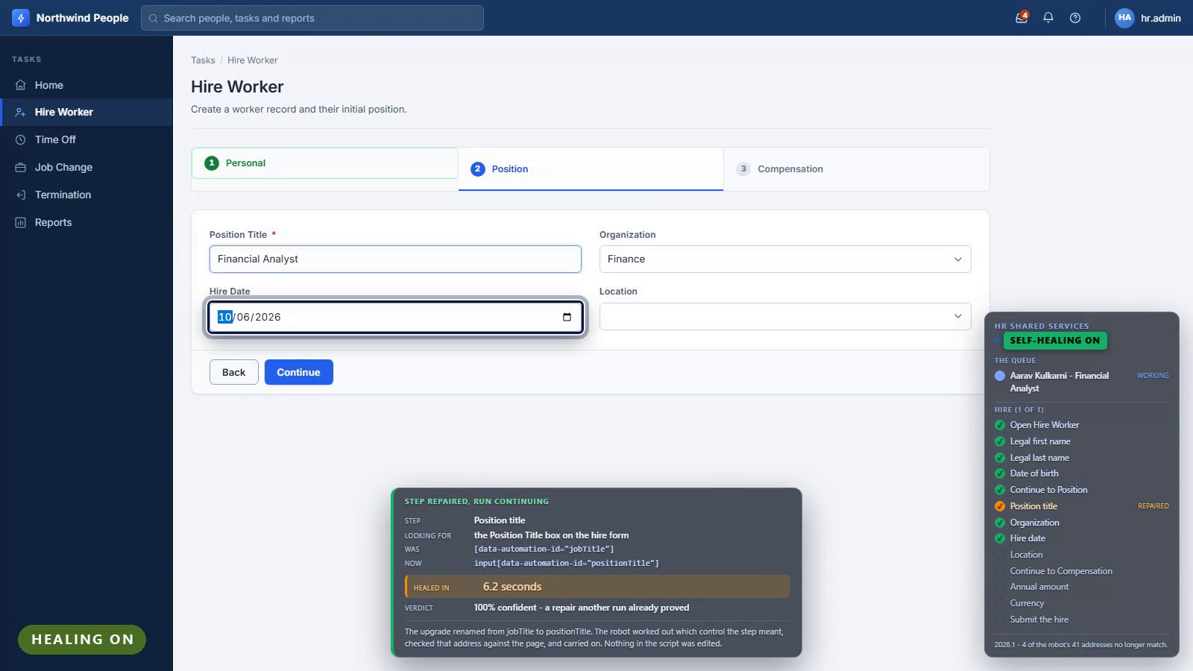
SAMSUNG SDS | LIVE DEMO · THE AGENT AT WORK
What the operations team sees: the agent healing live.
Demo video. Click to play: before the release, Healing Agent off, Healing Agent on.
PAGE 08 / 10
Confidential
SAMSUNG SDS
Notes:
32-second video, three parts, all on the HR portal: on release 2025.1 the robot files a new hire unattended; on 2026.1 with the Healing Agent off it stops at the renamed Position Title field; on 2026.1 with the Healing Agent on, the card says what broke, what it found and how sure it is, and the hire completes.
Design rules: business language, not stack traces; the control being used is ringed on screen; the overlay never intercepts a click, so it observes the run rather than changing it.

Slide 9








SAMSUNG SDS | BENEFITS · BUSINESS & TECHNICAL
Business keeps running. Engineering stops chasing selectors.
BUSINESS BENEFITS
TECHNICAL BENEFITS
Overnight runs finish
No rewrite: add one file
Runtime healing: days to seconds
Works with Selenium & Playwright
~16,800 engineer-hours back a year
AI cannot invent a selector
Every decision auditable
One fix heals the whole fleet
Also: fails safe if the service is down · open weights on our hardware · nothing leaves the estate
PAGE 09 / 10
Confidential
SAMSUNG SDS
Notes:
Pick the column that matches your room and lead with it. Do not read all eight rows.
For operations: runs stop failing overnight for reasons nobody is awake to fix, and every decision the system made is written down.
For engineering: no rewrite - one client file beside an existing script - and it works with both drivers and both selector languages already in use. The AI picks an index; the page proves it.
The ₹87 L figure is the modelled saving from the ROI slide, not a measurement. The closing line is the strategic argument: the capability is ours, on our hardware, with no bill that grows as we succeed.

Slide 10
SAMSUNG SDS | COMMERCIAL CASE
The Healing Agent gives back ~16,800 engineer-hours a year.
6,400
THE MODEL · FIVE ASSUMPTIONS
selector breaks a year
500+
processes in scope
500 × 40 × 8% × 4 quarters
~40
locators per process
22,400
engineer-hours spent today
8%
break each quarter
6,400 × 3.5 h
16,800
3.5 h
engineer time per fix
engineer-hours saved a year
75%
healed without a person
22,400 h × 75% healed
PAGE 10 / 10
Confidential
SAMSUNG SDS
Notes:
Say the disclaimer before anyone asks. The engineering numbers are measured; these are a model. The dashed border is doing that job visually.
Invite challenge on the five assumptions directly: "If you think eight per cent is wrong, tell me your number and I will rerun this live." That invitation is what makes the slide credible.
The 75% heal rate is deliberately below our demo result. Do not quote 100% here.
Only the last line matters: ₹87 L a year recovered. Everything above is how we got there.

